Slide 1

WASH Data challenge

Slide 2
What does wash stand for?
WAter
Sanitation
Hygiene

Slide 3
Problem setting
The Sustainable Development Goals is a set of goals to guide global development until the year 2030
Specific Goal: to ensure the availability and sustainable management of water and sanitation for all
UNICEF works to reach the most vulnerable and disadvantaged children

Slide 4
The scary reality
Without these basic needs, the lives of millions of children are at risk.
For children under five, water- and sanitation-related diseases are one of the leading causes of death.
Every day, over 800 children die from preventable diseases caused by poor water, and a lack of sanitation and hygiene.

Slide 5
Unicef's goal
To achieve universal and sustainable water and sanitation services and the promotion of hygiene, with a focus on reducing inequalities especially for the most vulnerable children, wherever they are; both in times of stability and crisis.

Slide 6
Our role
Assumption: The quality of water, sanitation, and hygiene services can plausibly have a strong impact on key health and social outcomes such as nutrition, child health, vaccine performance, and child development.
Add value to the WASH data and answer critical questions:
What are the areas in the WASH sector where UNICEF should conduct developmental interventions and invest money?
Which are the populations/regions most at risk of being “left behind” in terms of WASH globally?
Provide data-driven evidence and suggest data solutions for stakeholder engagement and fund mobilization.

Slide 7
Starting point - wash dataset
Data from UNICEF
WAter – Sanitation – Hygiene
For Countries Worldwide
Data Per Year (1960-2017)

Slide 8
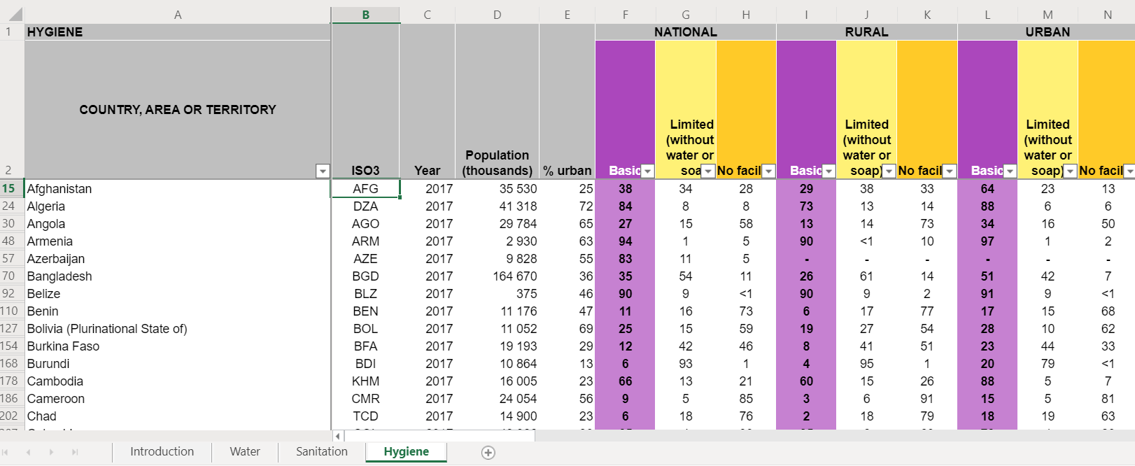
What do the data look like

Slide 9
Available for
Household
Healthcare Facilities
Schools

Slide 10
How are we going to tackle it
Look at WASH Data from Different Perspectives
5 Different Challenges

Slide 11
5 Challenges/Perspectives
Economy
Diseases
Child Health
Education
Nutrition

Slide 12
Agenda for the three days
Project Goal – Brainstorming without Data Limitation
Understand the Data – EDA + Visualization + Look for External Data
Brainstorming for Technical Solutions + Data Product Design
More EDA
Modelling - ML
Prototype - Demo
Story Telling - Presentation

Slide 13
Focus on
Data Value Chain: What value can we add to the data? What questions can be answered?
Creativity & Teamwork: Keep an Open Mind – Suggest Different Perspectives
Design Thinking – Conceptual Data Product For UNICEF

Slide 14
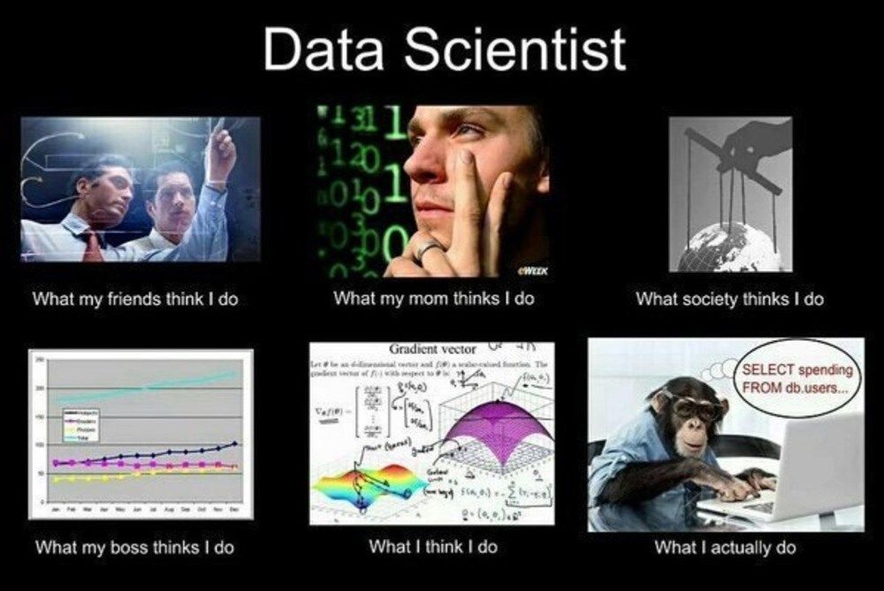
Let’s be Data Scientists!

